Slide 1
Bias and Variance
Bias is the simplifying assumptions made by the model to make the target function easier to approximate. Variance is the amount that the estimate of the target function will change given different training data.
The bias is known as the difference between the prediction of the values by the ML model and the correct value.
Variance describes how much a model changes when you train it using different portions of your data set.

Slide 2
Bias and Variance in ML
Machine learning algorithms use mathematical or statistical models with inherent errors in two categories: reducible and irreducible error. Irreducible error, or inherent uncertainty, is due to natural variability within a system. In comparison, reducible error is more controllable and should be minimized to ensure higher accuracy.
Bias and variance are components of reducible error. Reducing errors requires selecting models that have appropriate complexity and flexibility, as well as suitable training data.
The total error of a machine-learning model is the sum of the bias error and variance error.

Slide 3
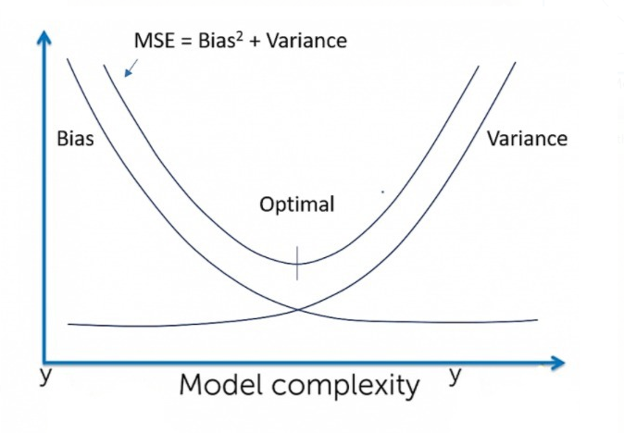
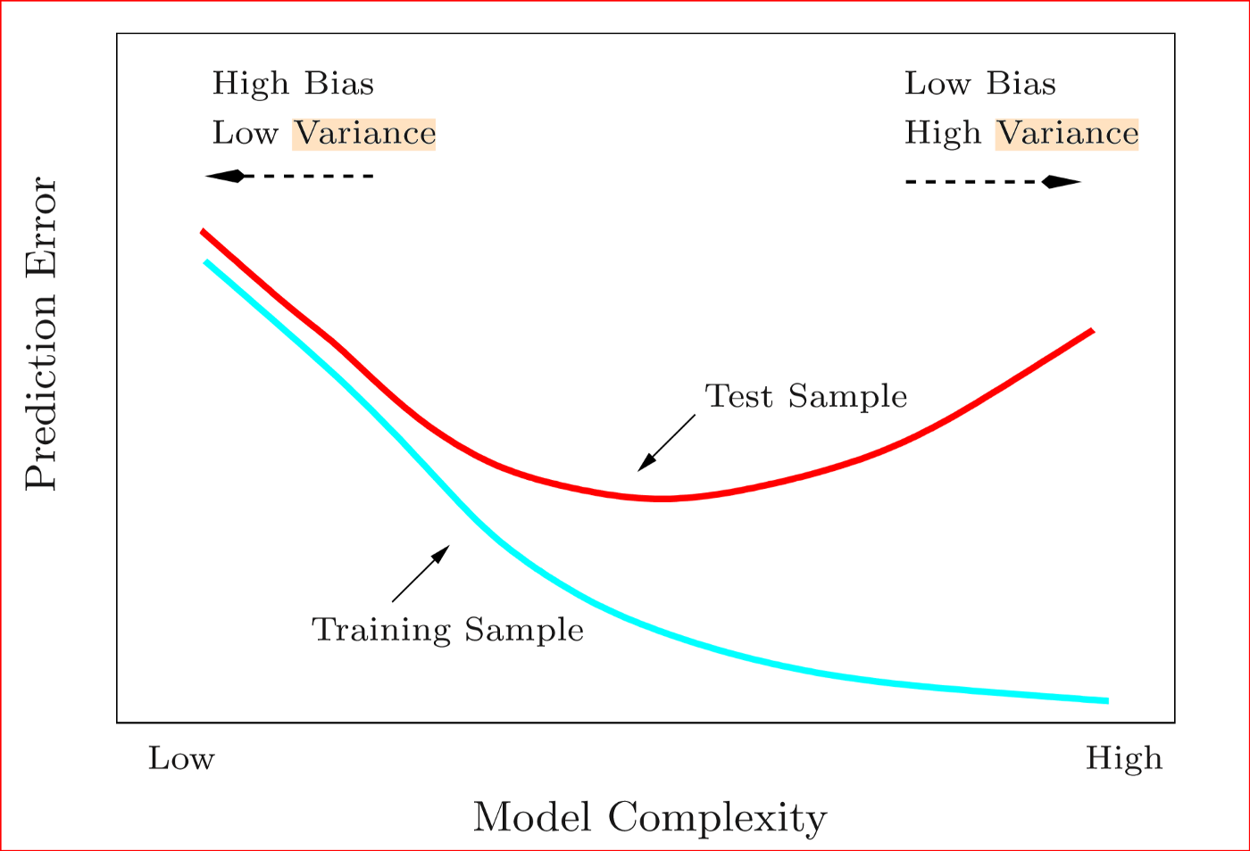
Concept of Bias and Variance

Slide 4
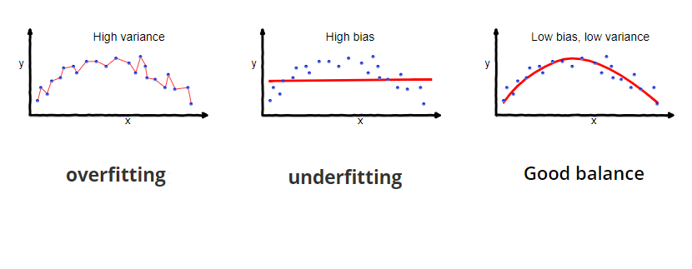
Overfitting: Good performance on the training data, poor generalization to other data. Underfitting: Poor performance on the training data and poor generalization to other data.
Underfitting happens when a model unable to capture the underlying pattern of the data. These models usually have high bias and low variance. ... overfitting happens when our model captures the noise along with the underlying pattern in data. It happens when we train our model a lot over noisy datasets.

Slide 5
Bias and Variance in practice
To wrap things up, we can relate the Bias Variance decomposition to the commonly used terms overfitting and underfitting in the following informal way:
• Overfitting relates to having a High Variance model or estimator. To fight overfitting, we need to focus on reducing the Variance of the estimator, such as: increase regularization, obtain larger data set, decrease number of features, use a smaller model, etc.
• Underfitting relates to having a High Bias model or estimator. To fight underfitting, we need to focus on reducing the Bias in the estimator, such as: decrease regularization, use more features, use a larger model, etc. The first step in improving generalization error is to characterize which component in the decomposition has the highest contribution, and go after that component. Unfortunately there is no theoretically sound yet tractable way of calculating the breakdown. However there are certain heuristics that are extremely useful. Loosely speaking:
• Training error can be treated as the amount of Bias in the model or estimator. If the model is unable to fit the training data itself well, then it is likely that the model has High Bias. This is the underfitting regime.

Slide 6
